Slide 1
Blowing The Boy's Magic Horn
Institute for Natural Language Processing Institute of Literary Studies
Toni Bernhart, André Blessing, Julia Koch
Plotting Poetry 5 – Popular Voices
4–6 July 2022
Estonian Literary Museum, Tartu
Plotted and Synthesised Romanticism

Slide 2
»textklang«
»textklang« – Mixed-methods approach to investigate the interrelation between written lyric poetry and its sonic realisation
Partners and Team University of Stuttgart, Institute for Natural Language Processing – Jonas Kuhn (PI), André Blessing, Markus Gärtner, Kerstin Jung, Nora Ketschik, Nadja Schauffler, Julia Koch, Thang Vu University of Stuttgart, Institute of Literary Studies: Gabriel Viehhauser (PI), Toni Bernhart Deutsches Literaturarchiv Marbach: Sandra Richter (PI), Felix Dieterle, Gunilla Eschenbach, Anna Kinder
Project duration 2021–2023
Funded by the German Federal Ministry of Education and Research

Slide 3
Aims of »textklang«
In general Investigating the interrelation between written lyric poetry and its sonic realization in recitation and musical performance Analyzing prosody in written poetry and sonic realization (interjections, enjambments) Developing text-to-speech (TTS) synthesis Perception studies on prosody Collecting metadata to visualize intertextuality and intermediality
In this presentation Plotting data and metadata (keshif app) Plotting sounds (TTS synthesis)

Slide 4
»textklang« corpus
Centered on poetry of Romanticism
Fed from holdings of the German Literature Archive From library and archive: 4,250 printed texts, 2,400 manuscripts, 1,400 musical scores From the audio collection: 2,700 recordings (recitations, musical settings)
Increased by own production 700 poems from 'The Boy's Magic Horn' by Achim von Arnim and Clemens Brentano 180 'Children's and Household Tales' by the Grimm brothers

Slide 5
'The Boy's Magic Horn'
Achim von Arnim, Clemens Brentano: Des Knaben Wunderhorn. Alte deutsche Lieder. [The Boy's Magic Horn. Old German Songs.] 3 vols. Heidelberg, Frankfurt am Main 1806–1808.
More than 700 lyric texts (versified and rhymed), and very few (parts of) texts in prose
Genres: songs, ballads, children's verses, prayers, short plays
Subjects and themes: everyday's life, religion and faith (esp. Catholic), history, myths, nature, societal and political experiences (esp. in rural environments)
Deeply rooted in late-medieval / Early Modern literary tradition
Vivid reception both in 'low' folkloristic cultures and in 'high' cultures, intermedial (esp. musical) impact (e.g. on G. Mahler, J. Brahms, F. Silcher, R. Schumann, B. Dylan)

Slide 6
'The Boy's Magic Horn' data
Text (txt) files Based on Deutsches Textarchiv https://www.deutschestextarchiv.de/ (CC BY-SA 4.0) Corrected or modified according to the first edition from 1806/1808 (image provided by Münchener Digitalisierungszentrum https://www.digitale-sammlungen.de/) and to the scholarly edition by Heinz Rölleke (6 volumes, 1975–1978) Modified in accordance with the recorded audio files, if necessary
Audio (wav) files Speaker Toni Bernhart Recorded at IMS Phonetic Lab (Head Wolfgang Wokurek), University of Stuttgart 15 GB (30 hours) 48 kHz 24 bit wav (24 June 2022), 26 GB (52 hours) expected Signal chain and tools: Neumann U 87 Ai (omni), Yamaha 1608-D, Yamaha CL1, Dante Controller 4.1.0.5, Steinberg Nuendo live 1.1.0, Audacity 3.1.3

Slide 7
'The Boy's Magic Horn' metadata
Titles of the texts in 'The Boy's Magic Horn'
Number of tokens per text
Genres of the texts in 'The Boy's Magic Horn'
Level of expressivity
Authors of sources and pre-texts
Publication year of sources and pre-texts
In addition, authors are classified by identifiers, if available.

Slide 8
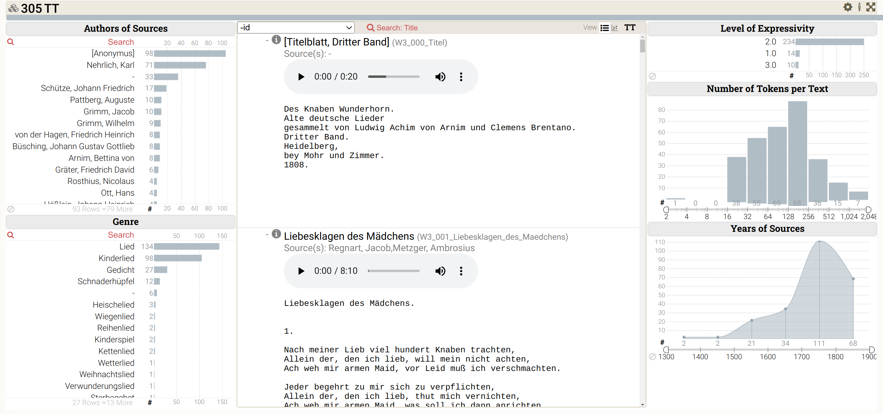
Keshif
Web-based visualization and analytics tool
Explore datasets quickly
https://github.com/adilyalcin/Keshif

Slide 9
Data preparation
Collect all meta data
Put it into a JSON file
Import to Keshif

Slide 10
Try out
A preliminary edition will be online for a few weeks:
https://clarin03.ims.uni-stuttgart.de/pp/wunderhorn.html

Slide 11
Speech Synthesis
Experiment:
Train Text-to-Speech Synthesis (TTS) on our recordings of 'The Boy's Magic Horn‘
linguistic variety and wealth in topics and genres makes it an interesting dataset
no restrictions through copyright
How does TTS perform poetry?
Is it enough to simply train on poetic data?

Slide 12
TTS - Background
Slide adapted from Florian Lux

Slide 13
TTS - Background
Slide adapted from Florian Lux

Slide 14
TTS - Background
Slide adapted from Florian Lux

Slide 15
TTS - Background
Infinite number of possibilites to say one sentence
speaker‘s voice, accent, prosody, emotion, style, …
Learned from data
requires huge amount of audio segments and matching text
audio segments should be ~5 -15 seconds long
Slide adapted from Florian Lux

Slide 16
TTS - Background
Slide adapted from Florian Lux

Slide 17
TTS - Background
Slide adapted from Florian Lux

Slide 18
Challenges
Non-standard text
Uncommon words (old words and wordforms, proper names, neologisms, onomatopoeia,…)
Inconsistent and old spelling (e.g. Roß - Ross, bey – bei, ae/oe/ue – ä/ö/ü)
phonemizer will make lots of mistakes
Inconsistent shape and formatting of text
e.g. stanzas mixed with explanations, random line breaks vs enjambments
Non-standard speech
Unusual stress due to metre of poems
Creative freedom in realization
e.g. variation in speaking rate, expressiveness, …
…

Slide 19
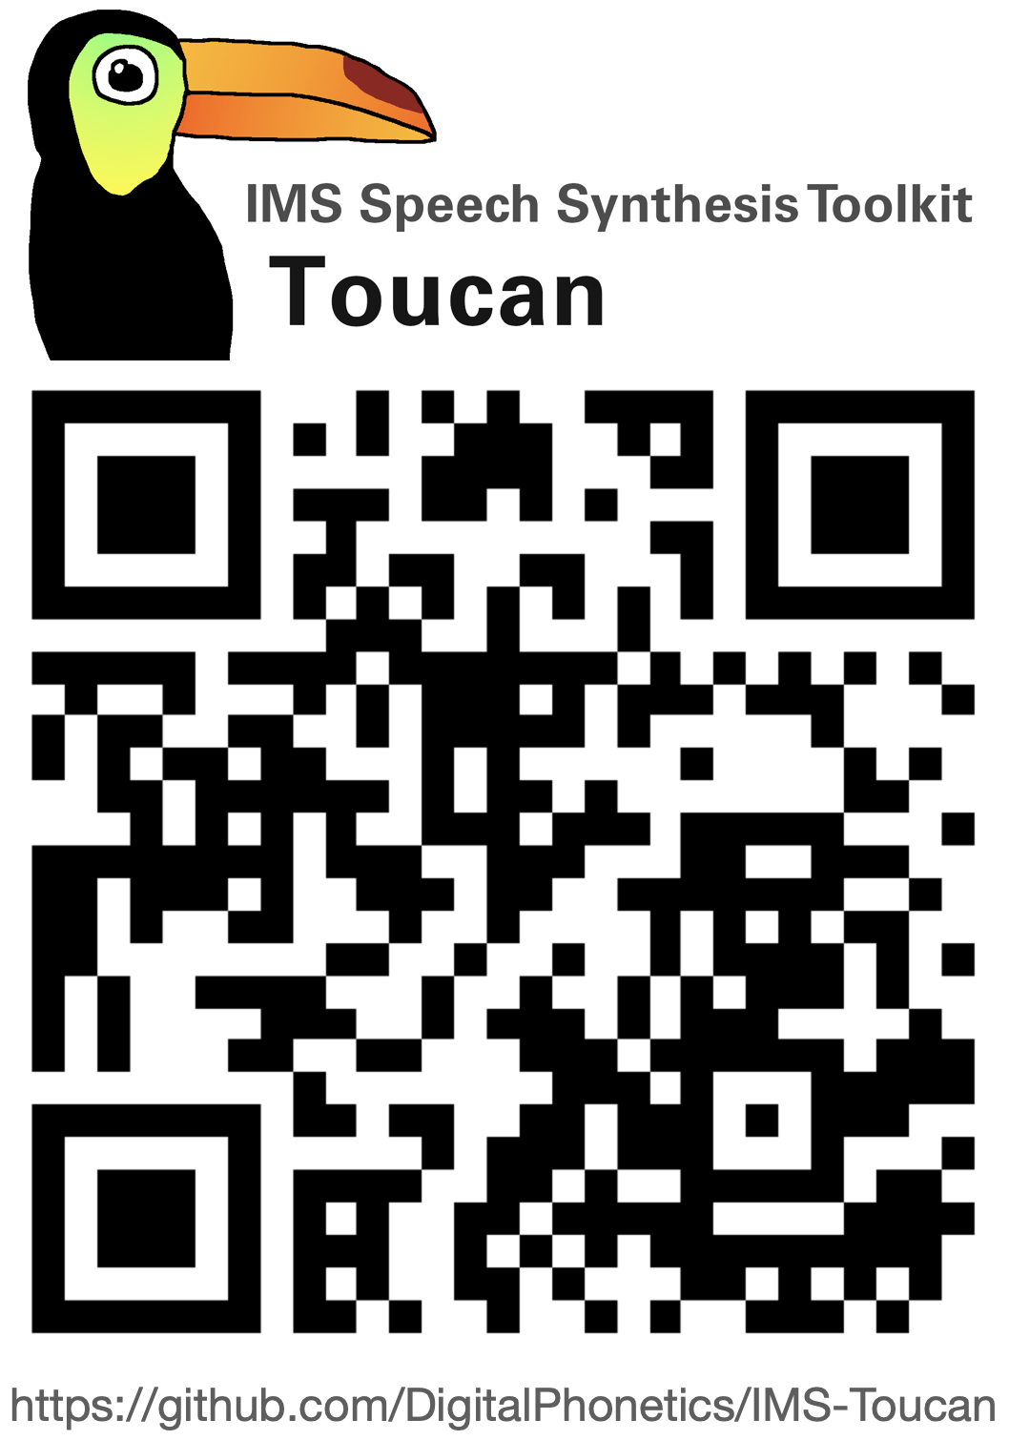
Experiment
Experiment Idea: compare TTS model trained on prose to TTS trained on poetry
Multilingual pretraining on ~400h of training data in 14 languages
Baseline: finetune for 10.000 steps on German prosaic data
Poetry Model: additional finetuning from baseline for 5.000 steps on 'The Boy's Magic Horn'
Automatic preprocessing of 211 poems:
cut text and audio into chunks of 2 verses
remove problematic samples
this leaves a reminder of 2.348 text-audio pairs

Slide 20
Analysis
Visualization
»Maria, wo bist du zur Stube gewesen? Maria, mein einziges Kind!«
»Mary, where have you been to the parlour? Mary, my only child!«

Slide 21
Analysis
Speaking Rate
We compare poetry model, baseline and human speech on 7 unseen poems
Speaking rate: average number of phones per second
 | Poem 1 | Poem 2 | Poem 3 | Poem 4 | Poem 5 | Poem 6 | Poem 7
Human | 9.21 | 10.24 | 9.41 | 9.70 | 10.10 | 12.03 | 11.75
Baseline | 12.52 | 13.02 | 12.36 | 12.51 | 13.11 | 13.08 | 13.20
Poetry | 10.03 | 11.12 | 10.05 | 10.08 | 10.99 | 10.60 | 11.29

Slide 22
Analysis
Duration of Pauses
Average duration of pauses in seconds
excluding silences at beginning and end
 | Poem 1 | Poem 2 | Poem 3 | Poem 4 | Poem 5 | Poem 6 | Poem 7
Human | 0,35 | 0,13 | 0,20 | 0,29 | 0,28 | 0,25 | 0,13
Baseline | 0,04 | 0,04 | 0,04 | 0,06 | 0,06 | 0,04 | 0,04
Poetry | 0,08 | 0,11 | 0,09 | 0,08 | 0,11 | 0,77 | 0,06

Slide 23
Some Examples
Poem 1: Das Wunderhorn
[The Magic Horn]
»Ein Knab auf schnellem Roß Sprengt in der Kaisrin Schloß«
»A boy on a swift horse dashes into the empress's castle«
Human | Baseline | Poetry

Slide 24
Some Examples
Poem 6: Knecht, Magd, Ochs, Esel und alles, was mein ist
[Servant, Maid, Ox, Donkey and all that belongs to me]
»Entequentlein heißt mein Entlein, Bibberlein heißt mein armes Hünelein.«
»Entequentlein is the name of my duckling, Bibberlein is the name of my poor little chicken.«
Human | Baseline | Poetry

Slide 25
Some Examples
Poem 7: Kinderkonzert
[Childrens Concert]
»Dill dill dill, so macht meine Flöt, Rum rum, bidi bum, so macht meine Trumm.«
»Dill dill dill, so goes my flute, rum rum, bidi bum, so goes my drum.«
»Rum bum, bidi bum, dill dill dill, ging ging ging, bring bring, bring.«
Human | Baseline | Poetry
Human | Baseline | Poetry

Slide 26
Summary
'The Boy's Magic Horn' is a canonical and divers collection of romantic poetry
this makes it paradigmatic for many research questions
the synopsis of text and audio files and metadata allows to study prosodic patterns in text and sonic realisation
TTS and the Magic Horn:
automatic processing is difficult both on text and audio side
TTS speech quality is impaired by noisy data
nevertheless, TTS model captured some stylistic properties, e.g. speech rate and pauses
still, some stylistc elements cannot be captured easily

Slide 27
Institute for Natural Language Processing Institute of Literary Studies
Thank you.
Julia Koch
<julia.koch@ims.uni-stuttgart.de>
Toni Bernhart
<toni.bernhart@ilw.uni-stuttgart.de>

